Slide 1
Lasers4EU
A central platform for laser research and innovation
Duration: 01 Oct 2024 – 30 Sept 2028
EU Funding: 5 M€

Slide 2
Objectives
continue, enlarge & improve services to users by
providing coordinated access to high-quality services
  from primary and secondary laser sources to a wide range of laser-based instruments & techniques
  through 3 different access routes for laser-based curiosity-driven
  fundamental science & applications
increasing the European basis of human resources
  through user training & professional staff development
shaping the European landscape of laser Research Infrastructures through networking & science diplomacy

Slide 3
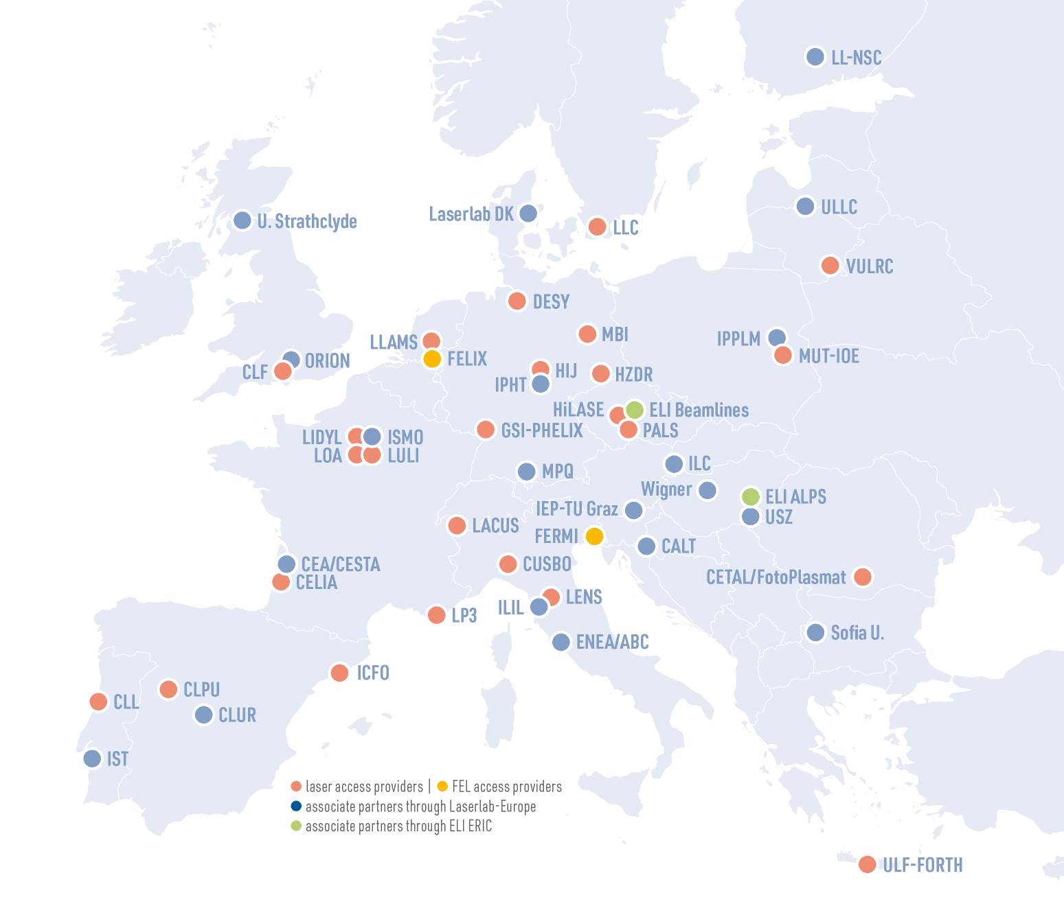
Participants: the power of diversity
25 Beneficiaries in 15 countries
29 Partners : 27 APIs + ELI ERIC
& Laserlab-Europe AISBL
All members of ELI ERIC and Laserlab-Europe AISBL are associated partners

Slide 4




Transnational Access (TNA) (1/4)
3 routes to pioneering laser research
3 Access routes :
Single-instrument
For users interested in transnational access and looking for a suitable laboratory for their access project, from fundamental science to validating a practical application.
Multi-instrument
For users who need access to as many installations as required in different facilities, over several years if necessary. Requires only a single proposal for the whole duration.
Industry
Allows companies to access the most recent techniques and methods in research laboratories and to benefit from the services of the partner facilities of Lasers4EU.
for researchers
across the globe
> 3000
access days
300
user projects
80%
of total budget
portfolio of techniques & instrumentation

Slide 5
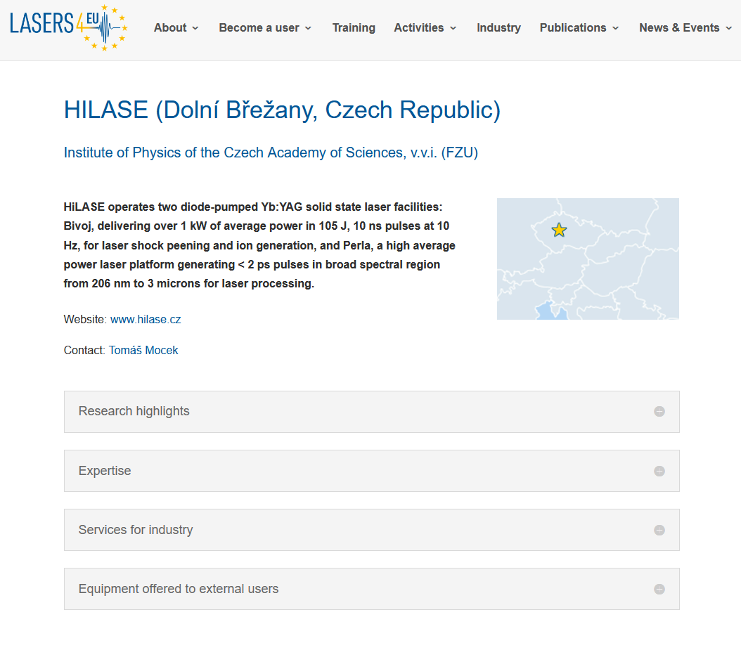
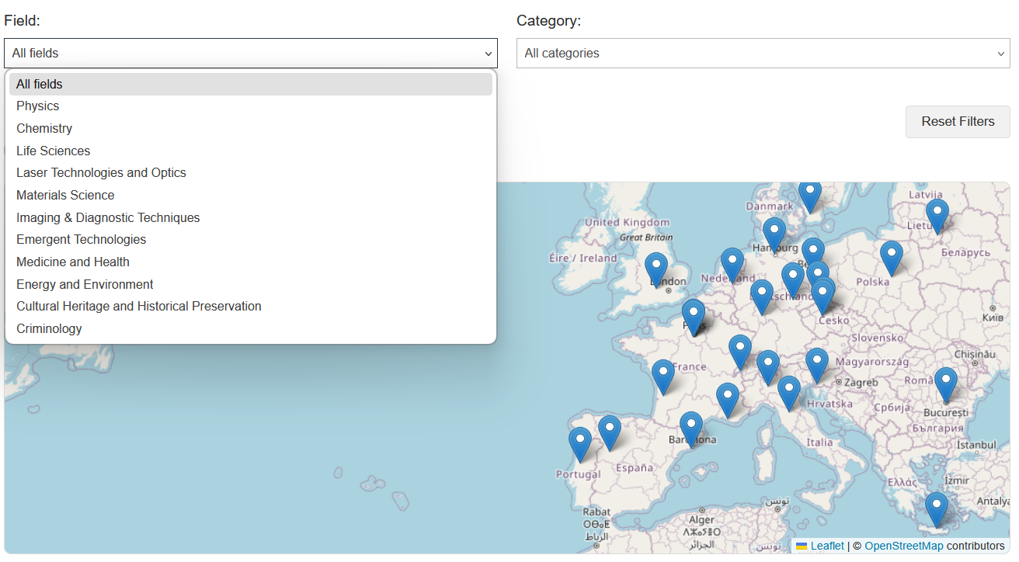
Transnational Access (TNA) (2/4)
Partner profiles & access search tool
https://lasers4.eu/find-a-lab/

Slide 6
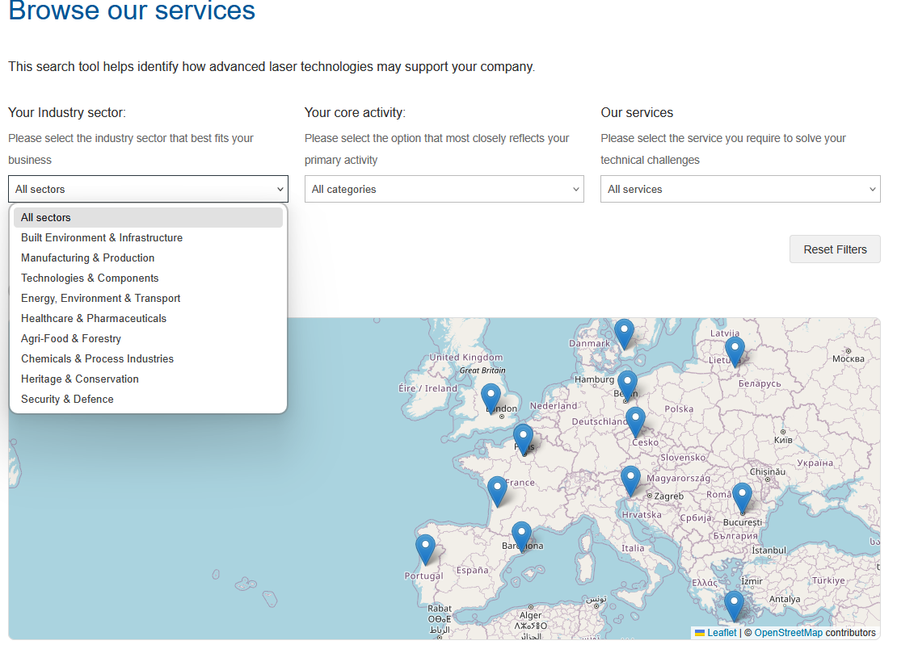
Transnational Access (TNA) (3/4)
Industry Search Tool
https://lasers4.eu/
industrysearchtool

Slide 7




Transnational Access (TNA) (4/4)
How does it work?
💡 All proposals must be submitted through a single central online portal.
Submit a proposal: Researchers apply via a central online portal, selecting a facility that best suits their technical and/ or scientific needs.
Transnationality requirement: The host lab has to be in another country than the scientist’s home institution.
Scientific review: Proposals are evaluated by an independent panel based on scientific excellence and feasibility.
Free access to the research infrastructures: Selected users receive free access to the infrastructure, including scientific, technical, and logistical support.
Where relevant, training for equipment use is also provided.

Slide 8






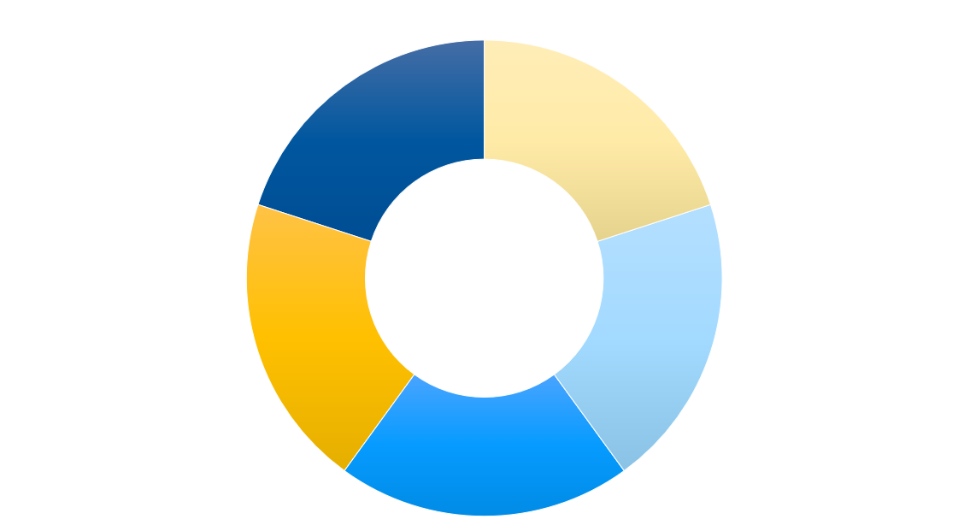
Cross-facility services
Check the webpage regularly for calls
Staff exchanges: scientific and technical training, know-how sharing and best practice.
Joint experiments for Lasers4EU APIs’ scientists to strengthen scientific collaboration.
Short-term R&D projects: improve the user-friendliness of the tools &
expand the range of instruments available
to users.
FAIRiness: DMP, FAIR network,
Helpdesk
Standardised performance assessment:
development of common protocols for performance and assessment for independent research fields.

Slide 9
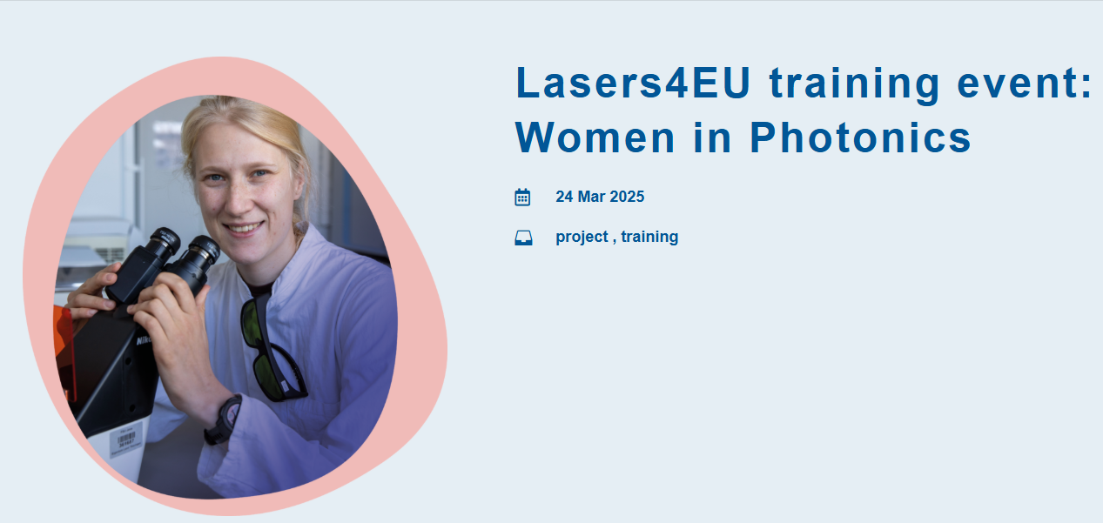

User training
Yearly user training schools
Training for non-specialists
Training of young scientist and users
Pre-project training
Preparation and training visit to the API for young researchers
MINDLAB: Manipulating and Investigating Neural Dynamics for Learning and Ageing in the Brain
Online Software tools
Creation of an online tool box for users to support with the preparation, execution and analysing of the experiments

Slide 10
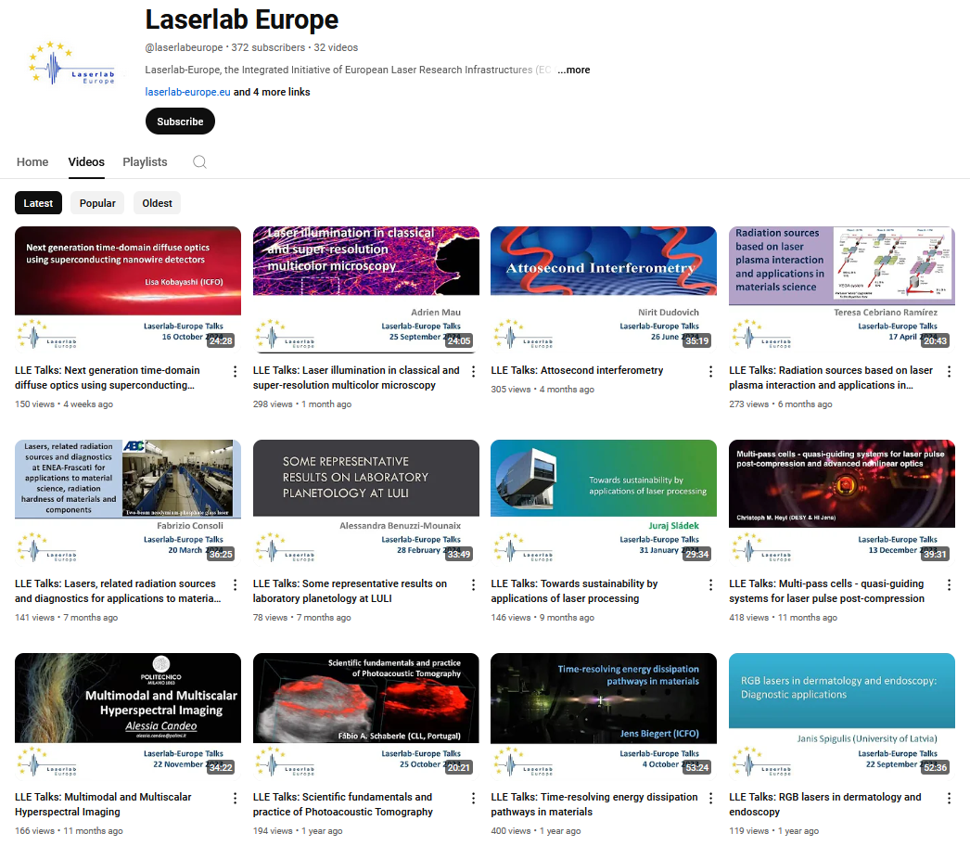
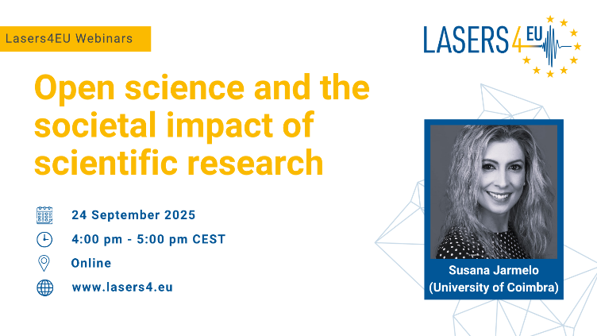
Services to the scientific community (1/2)
  Access to monthly scientific and technical webinars, showcasing research and applications enabled by laser-based technologies are presented
  Organisation of Lasers4EU webinars dedicated to topics as:
    Diversity and inclusion
    Intellectual Property rights
    Open Science
    Data management
    Patenting and technology transfer

Slide 11
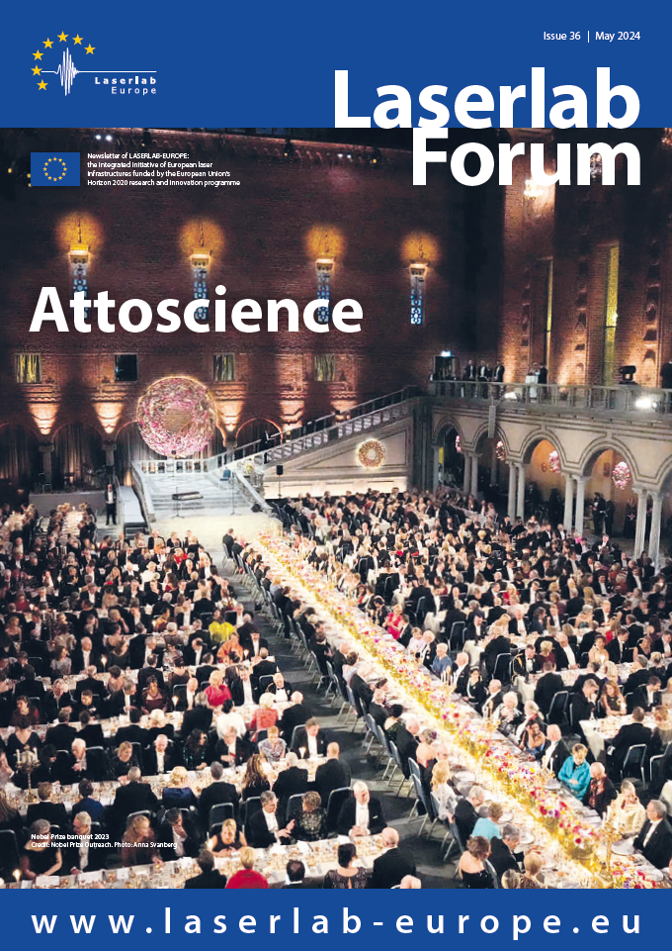


Services to the scientific community (2/2)
Newsletter Laserlab Forum every 8 months focusing on
      access opportunities
      user projects
      recent research highlights
      new services available for users
Publications database & knowledge management
      Publications resulting from access projects and
      cross-facility services will be listed on Lasers4EU |
      Open access to peer-reviewed publications and datasets

Slide 12


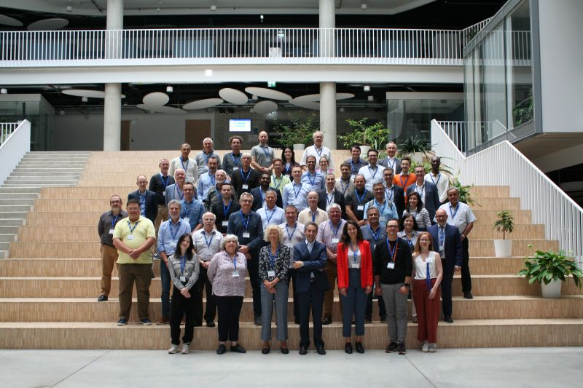
Networking & Outreach
Networking
  Network of points of contact in under-represented countries
  to increase the visibility of the Laserlab-Europe Network
  Online inventory platform to support the donation and reuse of second-hand scientific equipment.
Outreach
  Lasers4EU User Awards for curiosity-driven and for industrial projects (acknowledgment for the quality and impact of the user projects).
  User Meetings fostering collaboration and knowledge exchange among current and prospective users, as well as access providers, across disciplines.
  Lasers4EU Conference to present results and success stories from the community.

